Slide 1
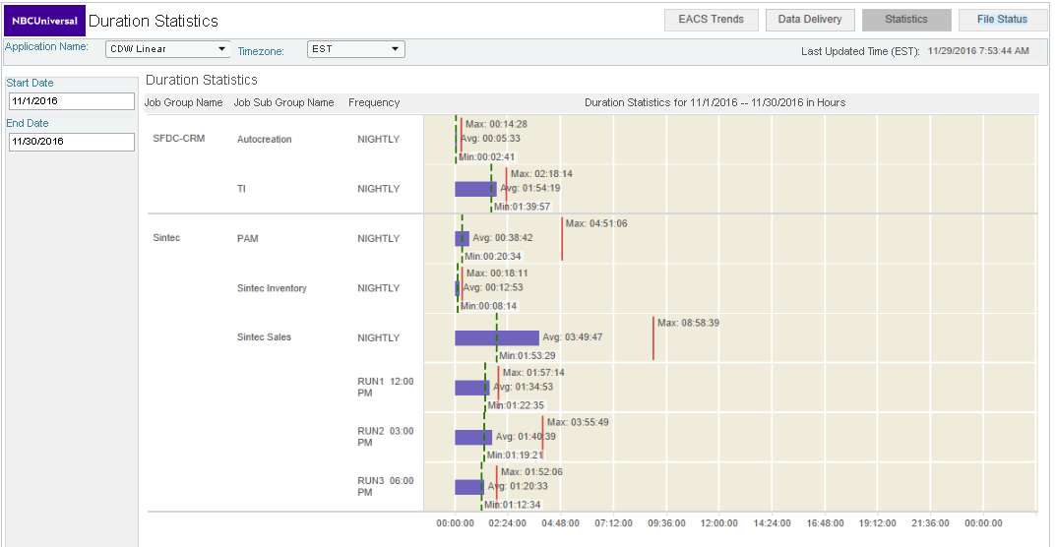
EACS Dashboard – Load Statistics

